Slide 1
Prediction of Breast Cancer Diagnosis
Eliza Chai & Ingrid Luo

Slide 2
Background
Breast cancer is the second most common cause of death from cancer in women in the US after lung cancer
Breast cancer occurs as a result of tumors
disordered proliferation and constant growth of cells in the breast tissue
Benign vs. Malignant tumors
determined by pathological examination, such as fine-needle aspiration (FNA)

Slide 3
Goal of the Study
Use classification techniques to predict the diagnosis of breast tumor tissues as either malignant or benign based on ten cytological features of each FNA of a breast mass
logistic regression model
random forest

Slide 4
Problem of Interest
Which are the most related features in predicting malignant or benign breast cancer?
What is the performance of the selected algorithm for breast cancer diagnosis?

Slide 5
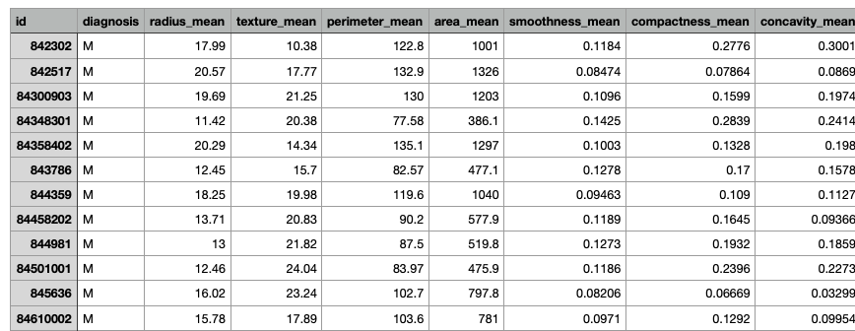
Dataset
Breast Cancer (Wisconsin) Diagnosis dataset
30 features describing the characteristics of the cell nuclei in the breast tissue present in image of FNA of a breast mass
568 rows/observations

Slide 6
Variables
Response variable
Diagnosis (M = malignant, B = benign)
Predictors/covariates
10 features (all quantitative)
radius (mean of distances from center to points on the perimeter)
texture (standard deviation of gray-scale values)
perimeter
area
smoothness (local variation in radius lengths)
compactness (perimeter^2 / area - 1.0)
concavity (severity of concave portions of the contour)
concave points (number of concave portions of the contour)
symmetry
fractal dimension ("coastline approximation" - 1)

Slide 7
Data Preparation
Missing data
No missing values in the covariates
Balance data (response variable)
63% of observations were benign, and 27% of observations were malignant
Slightly unbalanced

Slide 8
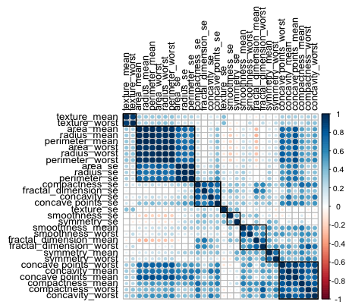
Data Preparation
Correlation
A few variables are correlated
Remove highly correlated predictors (corr > 0.7) with caret::findcorrelation()

Slide 9
Data Preparation
Multicollinearity
Fit a logistic regression model with all 9 variables and examine the variance inflation factor (VIF) (vif >10 indicates multicollinearity)
‘concavity_worst’ has the highest VIF (vif = 13.23) 🡪 drop
Refit the model with 8 variables and
Confirm all variables have VIF less than 10
Test-Train split
randomly assign 80% to training and 20% to test
Turn dataset into numeric
Create a new dataset by converting the original dataset into numeric (for random forest)

Slide 10
Modeling
Logistic regression
Logistic regression plus stepwise forward selection with AIC
Random forest classification

Slide 11
Results
Logistic Regression
Significant predictors: ‘texture_mean’, ‘perimeter_worst’, and ‘concave_point_worst’
(Wald test p=0.00006, p=0.0020, p=0.0007 respectively)
Misclassification error rate on the test set = 1.77%
Accuracy = 98.23%
Logistic regression plus stepwise forward selection with AIC
Significant predictors: ‘texture_mean’, ‘perimeter_worst’, ‘concave_point_worst’, and ‘symmetry_worst’
(Wald test p=0.00007, p=0.0000001, p=0.00017, p=0.042 respectively)
Misclassification error rate on the test set = 3.54% The prediction
Accuracy = 96.46%

Slide 12
Results
Random forest classification
Significant predictors: ‘texture_mean’, ‘perimeter_se’, ‘perimeter_worst’, ‘concave_point_worst’, and ‘symmetry_worst’
(Wald test p=0.0099, p=0.0099, p=0.0099, p=0.0099, p=0.049 respectively)
Misclassification error rate on the test set = 5.31%
Accuracy = 94.69%

Slide 13
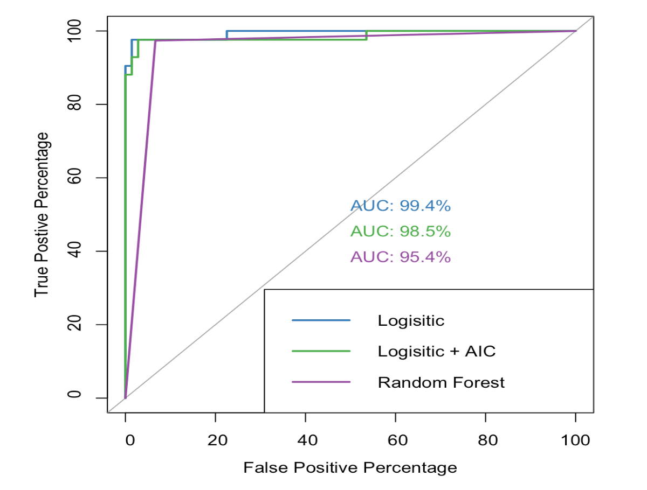
Results: ROC Analysis
Logistic regression has the best ROC curve and highest AUC
Random Forest has the worst ROC curve performance and lowest AUC

Slide 14
Conclusion
Overall, the logistic regression model with 8 features has the highest AUC, highest prediction accuracy, and the lowest misclassification error rate
Random forest has the lowest AUC, lowest accuracy, and highest misclassification error rate
Classification model | AUC | Accuracy | Misclassification error
logistic | 99.4% | 98.23% | 1.77%
logistic + stepwise forward AIC | 98.5% | 96.46% | 3.54%
random forest | 95.4% | 94.69% | 5.32%

